Slide 1
Dynamic Programming

Slide 2
Objective
Describe the Dynamic Programming Technique
Contrast the Divide and Conquer and Dynamic Programming approaches to solving problems
Identify when Dynamic Programming should be used to solve a problem
Define the Principle of Optimality
Apply the Principle of Optimality to solve Optimization Problems

Slide 3
Dynamic Programming (DP)
Dynamic Programming is an algorithm design technique for optimization problems
Often minimizing or maximizing an answer
Like Divide & Conquer, DP solves problems by combining solutions to subproblems
Unlike Divide & Conquer, subproblems are not independent
Overlapping subproblems

Slide 4
Dynamic Programming
We need to find a recursive formula for the solution
We can recursively solve subproblems, starting from the trivial case, and save their solutions in memory
Finally, we’ll get the solution of the whole problem

Slide 5
Lessons Learnt about DP
The key is to remember what has been computed so far
This is in fact “reusing” computation
Identify what are the subproblems
They help to solve the actual problem instance
Save the result obtained from subproblems

Slide 6
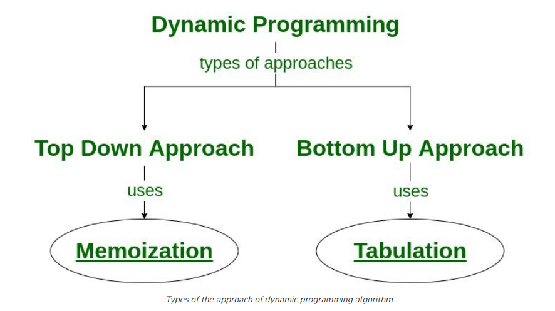
Dynamic Programming (DP)

Slide 7
Properties of a problem that can be solved with DP
Simple Subproblems
We should be able to break the original problem to smaller subproblems that have the same structure
Optimal Substructure of the problems
The solution to the problem must be a composition of subproblem solutions
Subproblem Overlap
Same subproblems are solved multiple times during the computation process

Slide 8
Steps in Dynamic Programming
Identify the problem as a DP problem
Check if the problem has overlapping subproblems
Check if the problem follows optimal substructure (i.e., the optimal solution to the overall problem depends on optimal solutions to subproblems).
Define the recurrence relation
Choose between Top-Down or Bottom-Up
Top-down method has overhead from recursive calls, so, the bottom-up approach is generally preferred!
Implement the solution
We’ll study these with the help of examples.

Slide 9
Example: Fibonacci Numbers
Recall what it was…
Fib(1)=Fib(2)=1
Fib(n)=Fib(n-1)+Fib(n-2)
How to obtain Fib(n)?
Recall the recursive algorithm which was a D&C approach!

Slide 10
Recall: Fibonacci Numbers using Divide & Conquer (D&C)
int fib (int n) { if (n==0) return 0;
if (n==1)
return 1
return fib(n-1)+fib(n-2);
}
Time complexity: O(2^{n})

Slide 11
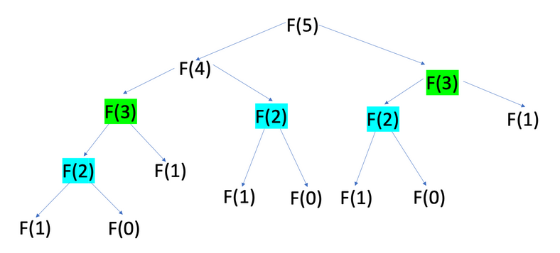
Fibonacci Numbers using DP top-down approach
Dynamic programming stores the intermediate results in an array to avoid redundant calculations.

Slide 12
Analysis of Fibonacci Numbers using DP
In the memoization (top-down) approach, we calculate each Fibonacci number once and store it.
Complexity when the result is already memoized is θ(1)
Overall time complexity → O(n)
def fib_memo(n, memo={}):
if n <= 1: return n
if n not in memo:
memo[n] = fib_memo(n - 1, memo) + fib_memo(n - 2, memo) return memo[n]

Slide 13
Bottom-Up feature of DP​
Let’s revisit Fibonacci Numbers algorithm (in non-recursive manner):
Start from the base cases (F(0) and F(1)) and iteratively calculate Fibonacci numbers up to the desired value of n.
O(n)
int memo={}
for i=1 to n:
if (i ≤ 2):
memo[i]=1
else
memo[i]=memo[i-1]+memo[i-2]
return memo[n]

Slide 14
Binomial Coefficient Problem
This is difficult to calculate for large values of n
We can eliminate the use of n! using the recursive formula:
if 0 < k < n
if k= 0 or k= n

Slide 15
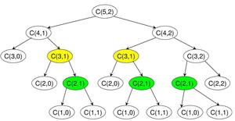
How to Solve Binomial Coefficient Problem
D&C approach is not efficient
Why?
It recursively breaking the problem into smaller subproblems C(n-1, k-1) and C(n-1, k)
The time complexity is exponential: O(2^{n})

Slide 16
Solve Binomial Coefficient with DP approach
Establishing Recursive Property with 2D-array
B[n][k]= B[n-1][k-1]+B[n-1][k] if 0<k<n
1 if k=0 or k=n
Solve an instance in a bottom-up fashion
Use a two-dimensional array (B)
Compute the rows in the array B
Start from the first row

Slide 17
Solving Binomial Coefficient Problem
int bin(int n, int k){
index i,j;
int B[0..n][0..k];
for(i=0; i≤n; i++)
for(j=0; j≤min(i,k); ++j){
if(j==0 || j==i)
B[i][j]=1
else
B[i][j]= B[i-1][j-1]+B[i-1][j];}
Return B[n][k];}
Apply the algorithm only for all k<=n

Slide 18
Analysis and Lesson Learn
The time complexity of the algorithm is O(nk)
Much better than the D&C approach O(2^{n})
Similarity of D&C and DP:
Both use recursive properties
They solve the problem for smaller sizes
Difference of D&C and DP:
D&C involves solving independent subproblems recursively,
DP involves solving overlapping subproblems and storing their solutions to avoid redundant computation

Slide 19
Principle of Optimality in DP
Many optimization problems can be solved using DP
However, not all optimization problems can be solved using DP
The “principle of optimality” must apply in the problem!

Slide 20
Principle of Optimality
The principle of optimality is applied in a problem if an optimal solution for a problem includes optimal solutions for all sub-problems
If the principle holds, we can provide a recursive solution and obtain optimal solutions from smaller ones

Slide 21
Example: when the principle holds
Shortest path from a node to another node in a graph
Suppose V_{k} is a vertex in an optimal path from V_{i} to V_{j}
Then the sub-path from V_{i} to V_{k} and from V_{k} to V_{j} are also optimal
Therefore, the principle of optimality holds!
V_{i}
15
V_{j}
5
V_{k}
4

Slide 22
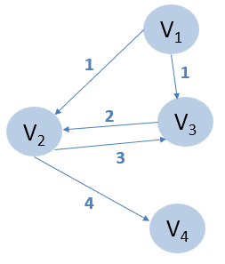
Example: when the principle of optimality does not hold
Longest simple path (no repeated vertex) from a vertex to another vertex in a graph
Find the longest path from V₁ to V₄
Consider: V₁, V₃, V₂, V₄
However, sub-path V₁ – V₃ is not the longest possible!
In fact, V₁ – V₂ – V₃ is the longest (with size=4)
Principle of optimality does not hold in this case!

